Slide 1

{Dev}School DevOps Edition 2023
Andrada Raducanu, Maria Jianu, Liviu Varia
August 2024

Slide 2

Agenda
Who are we?
Who are you?
The program
The calendar
Welcome word

Slide 3

Who are we?
{Dev}School DevOps Edition Core team

Slide 4
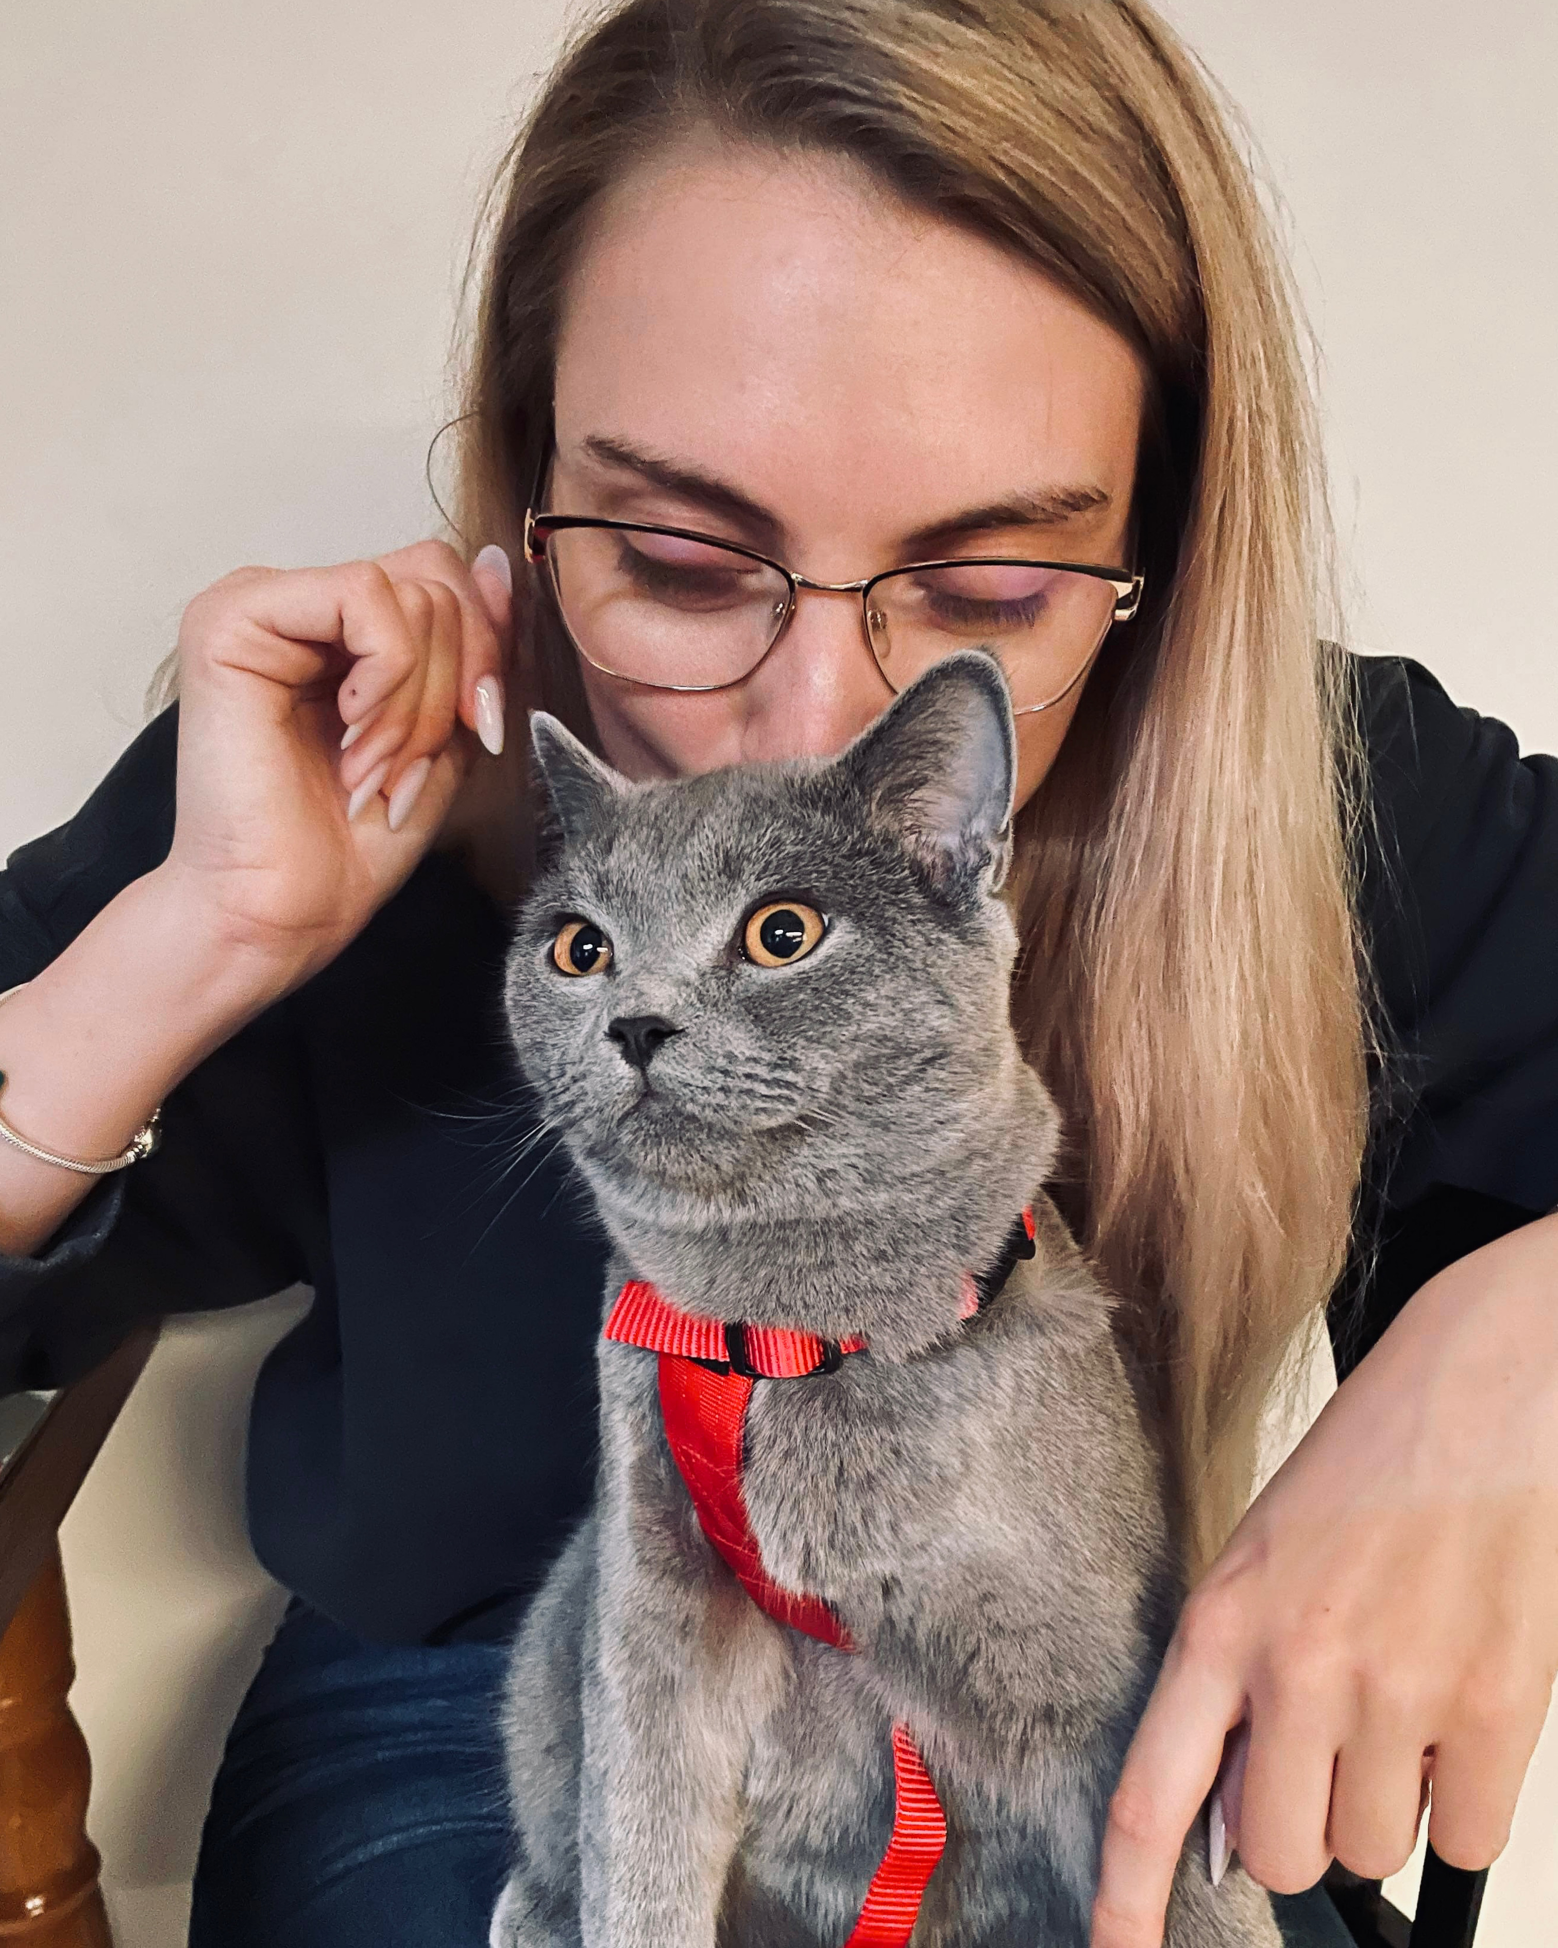
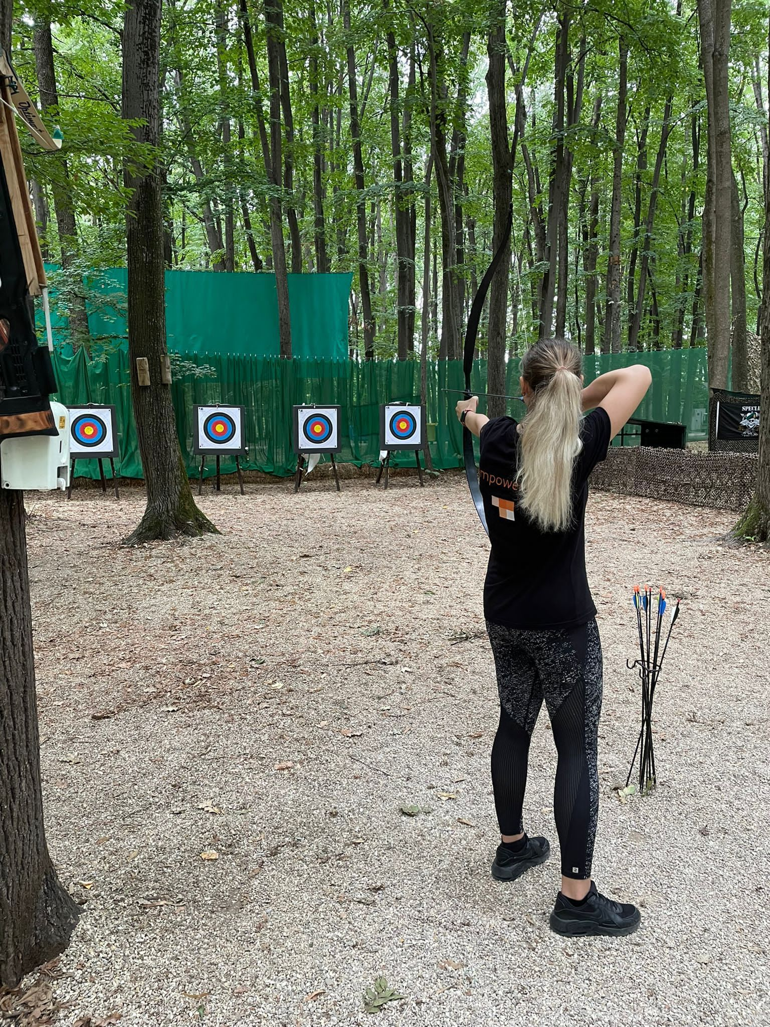
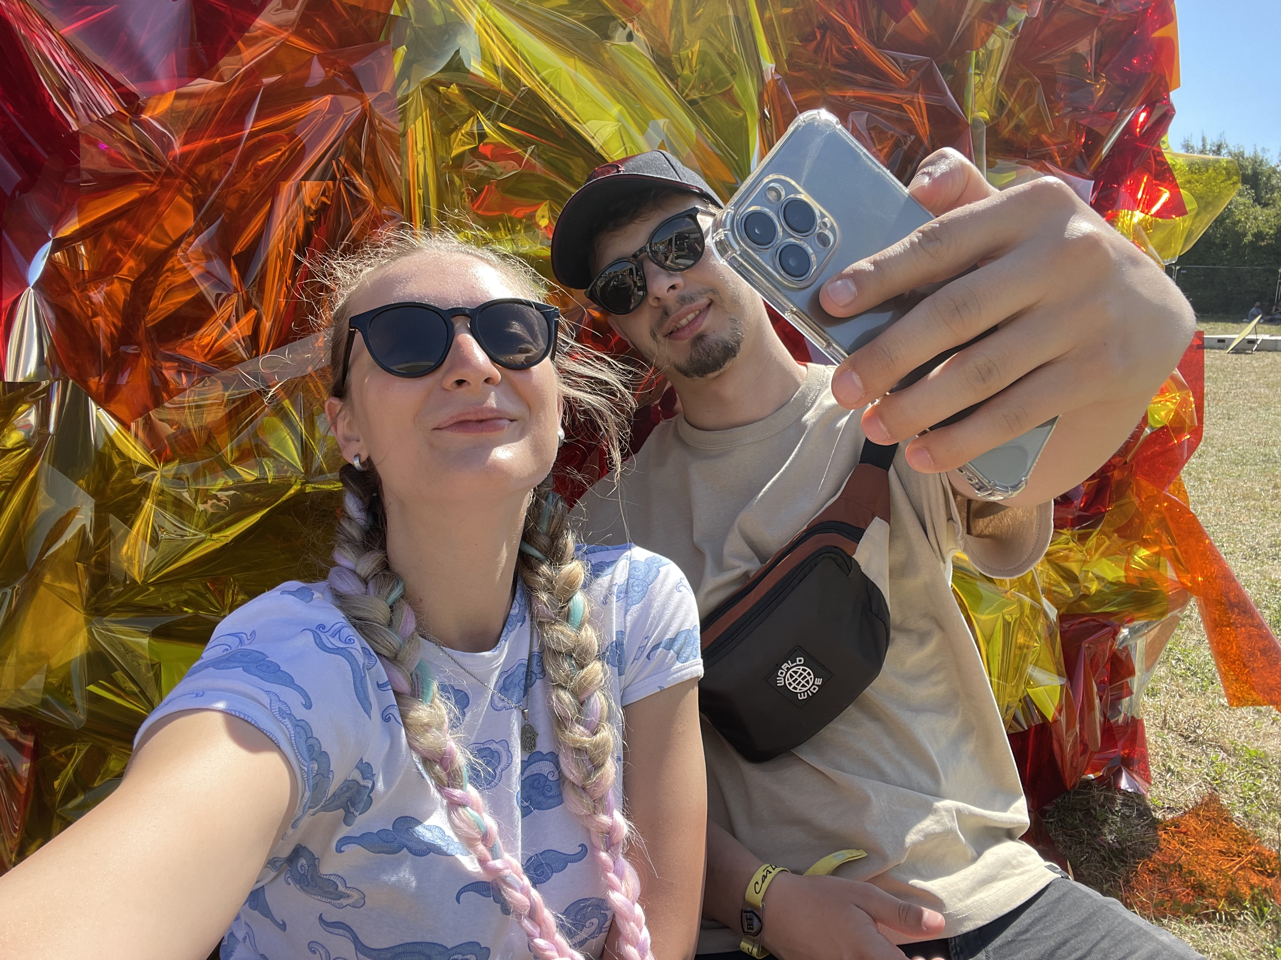
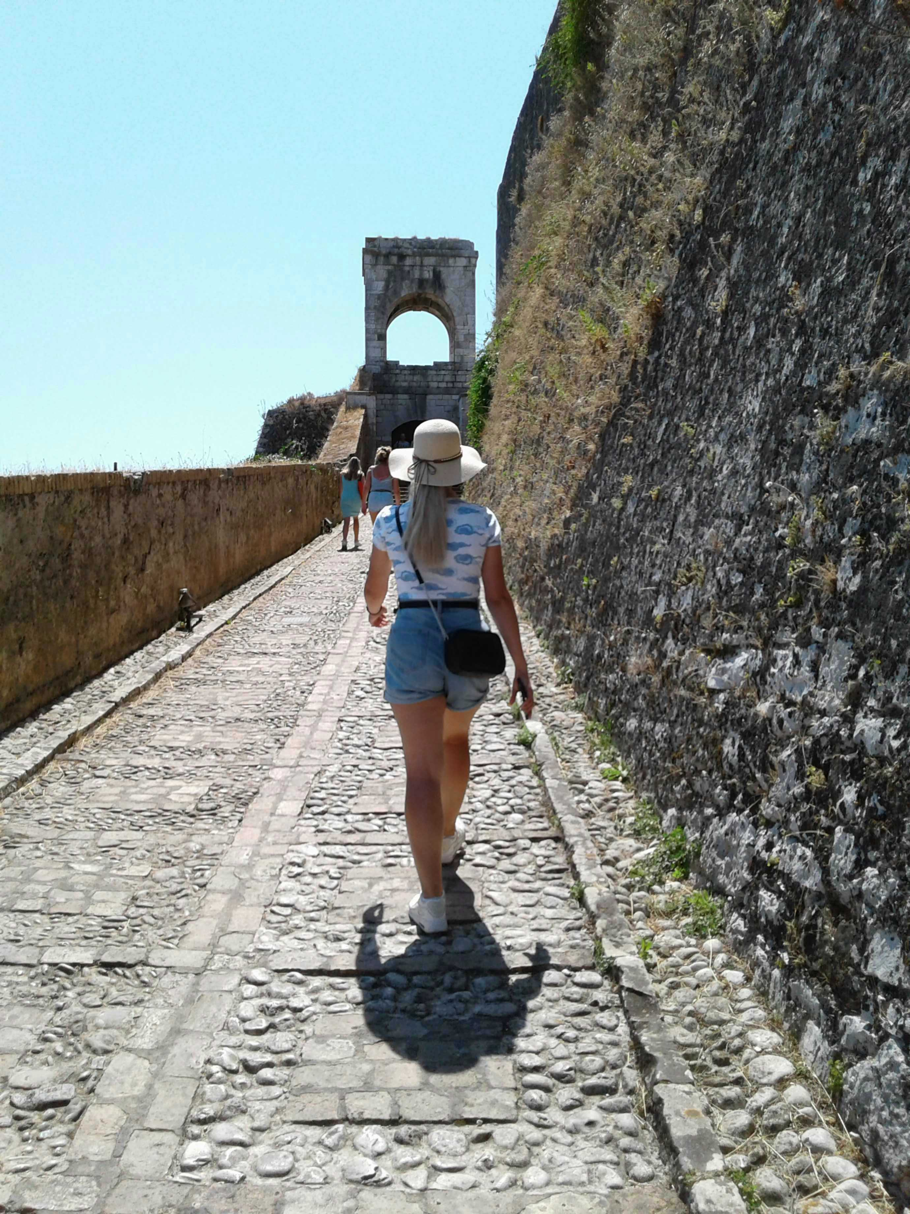
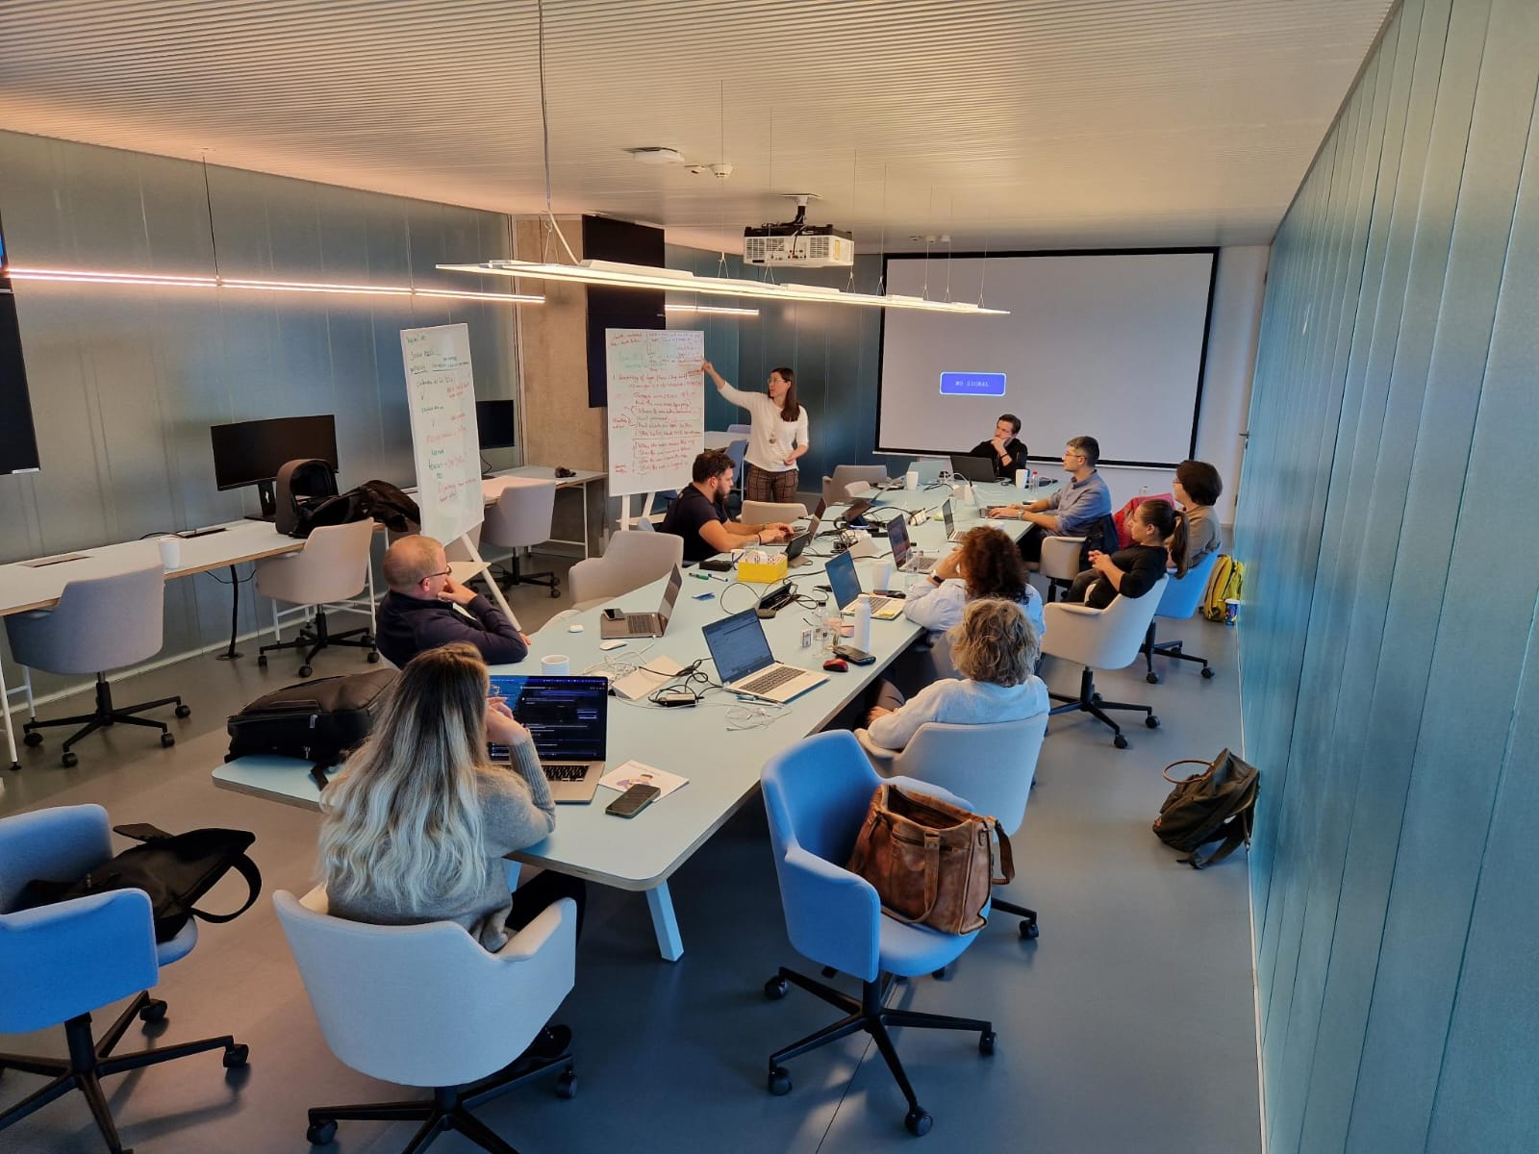
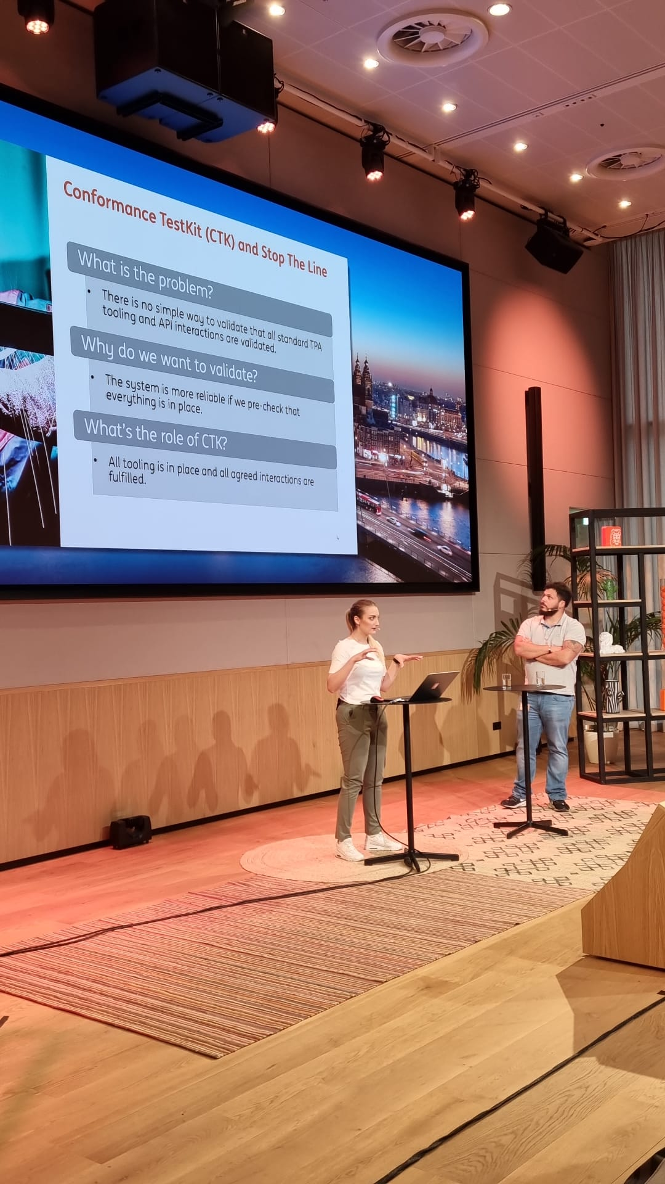

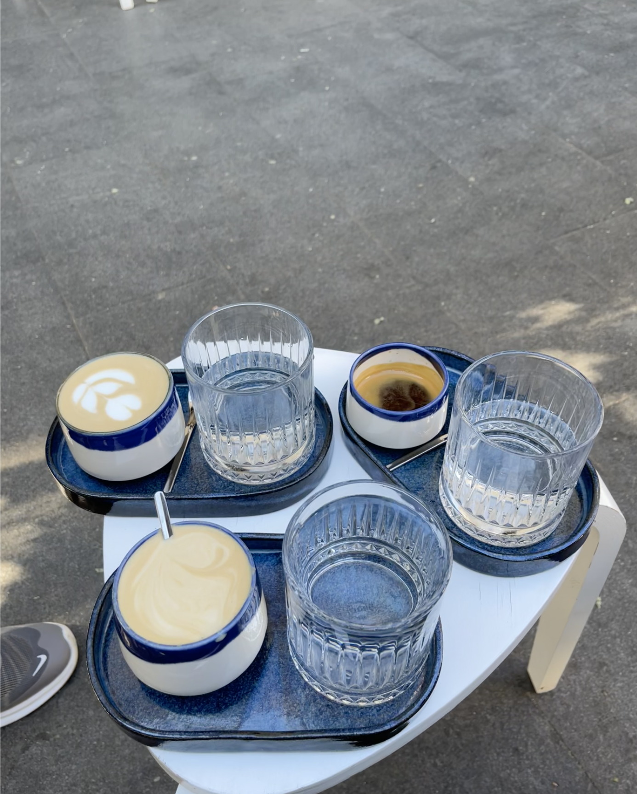
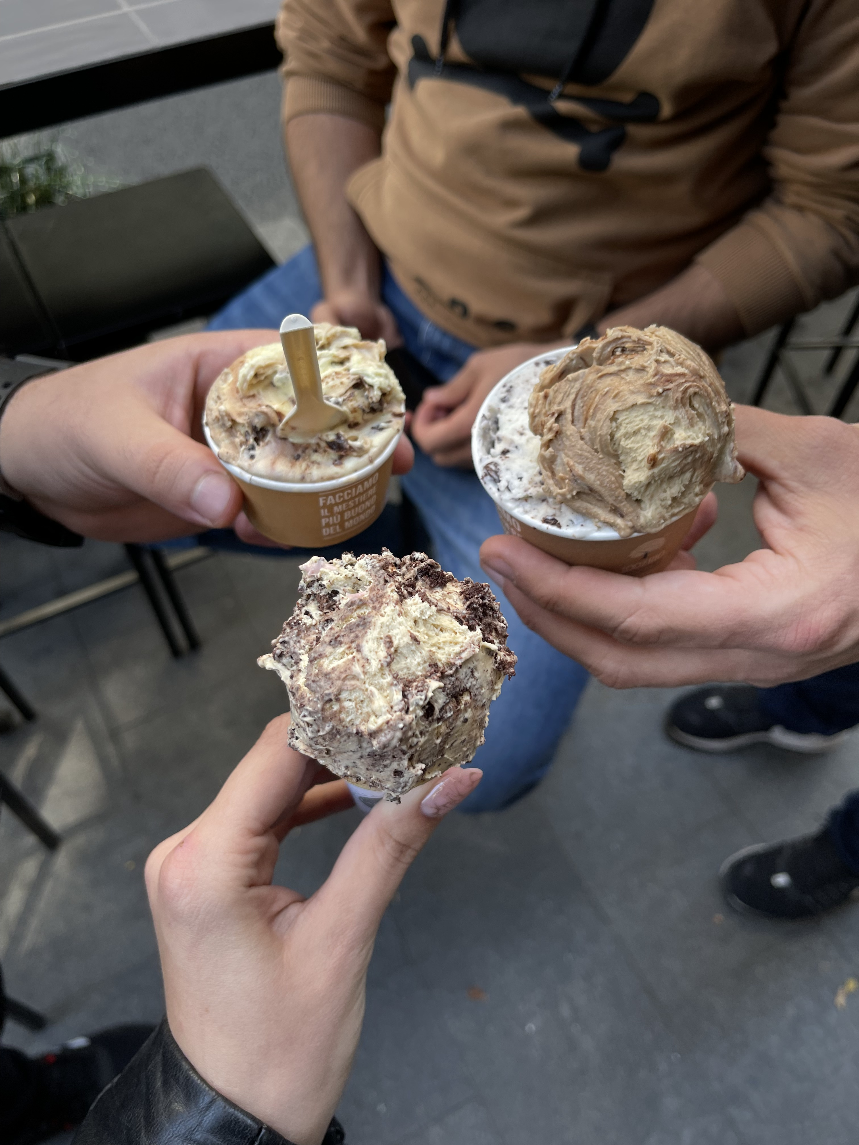
Andrada Raducanu

Slide 5
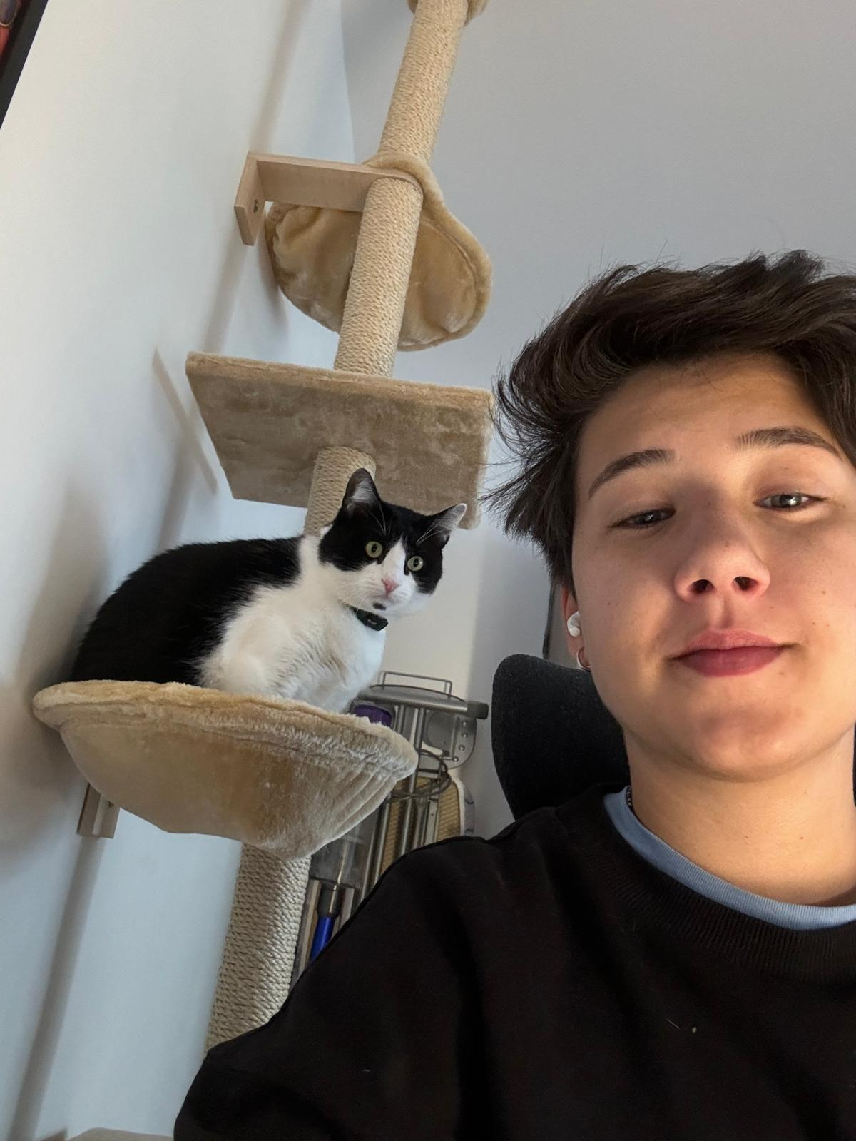
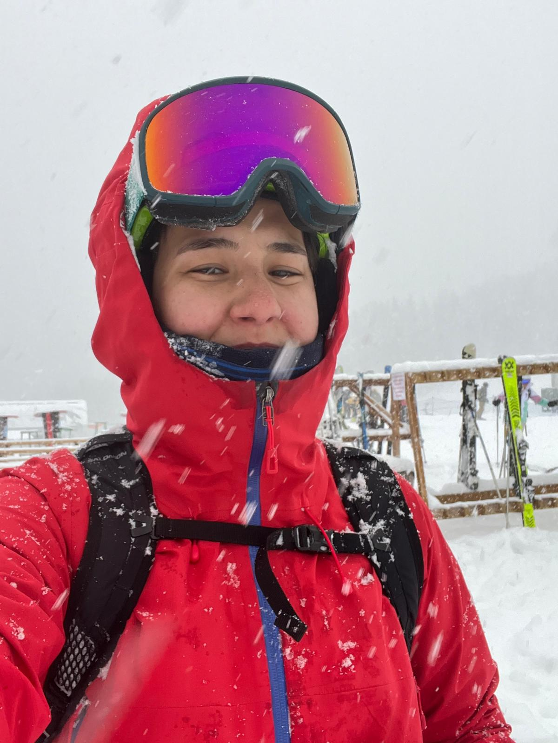

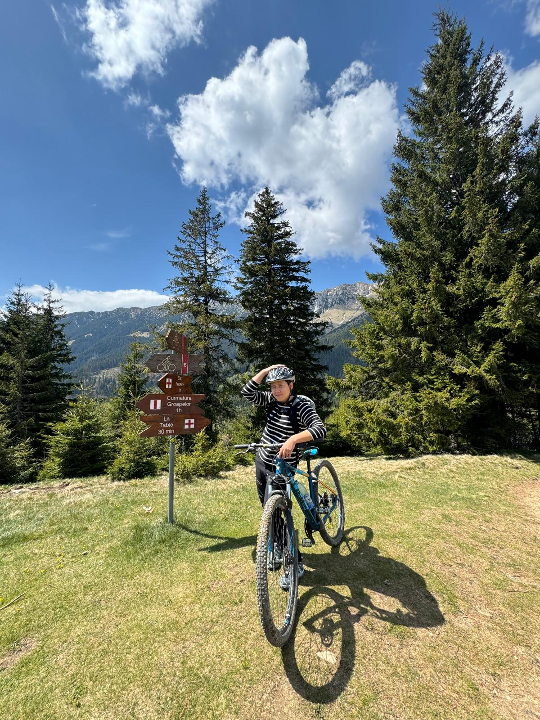
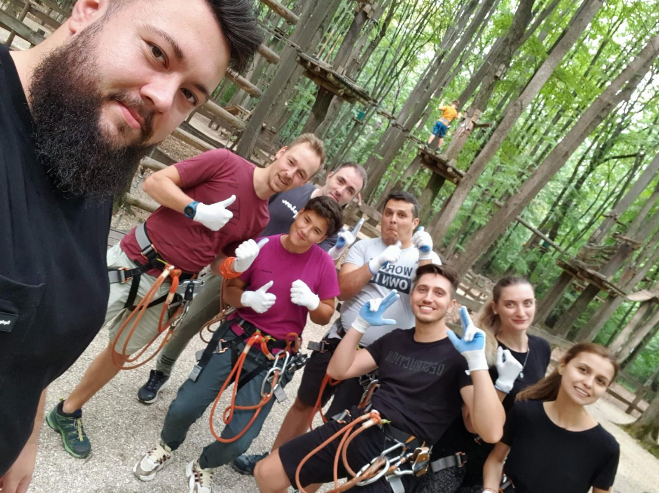
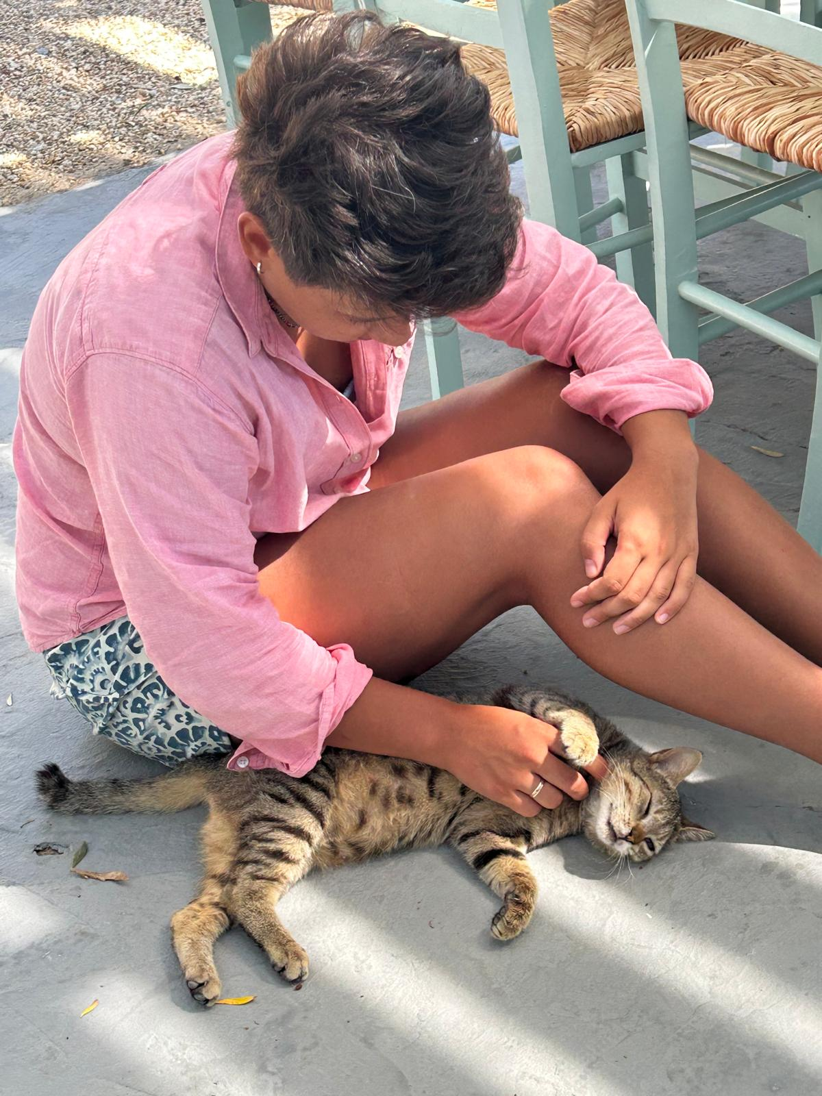
Maria Jianu

Slide 6
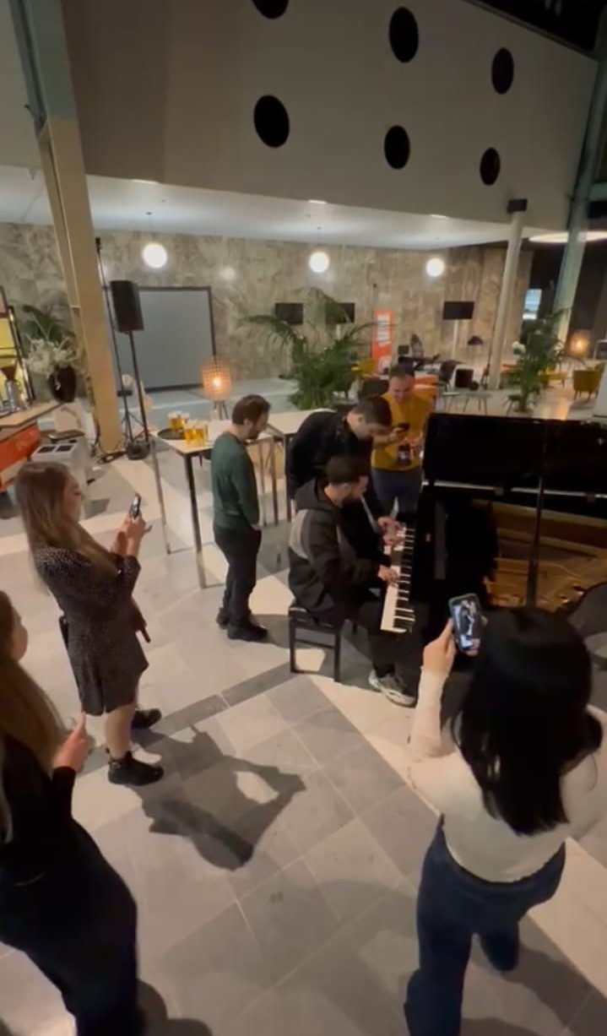
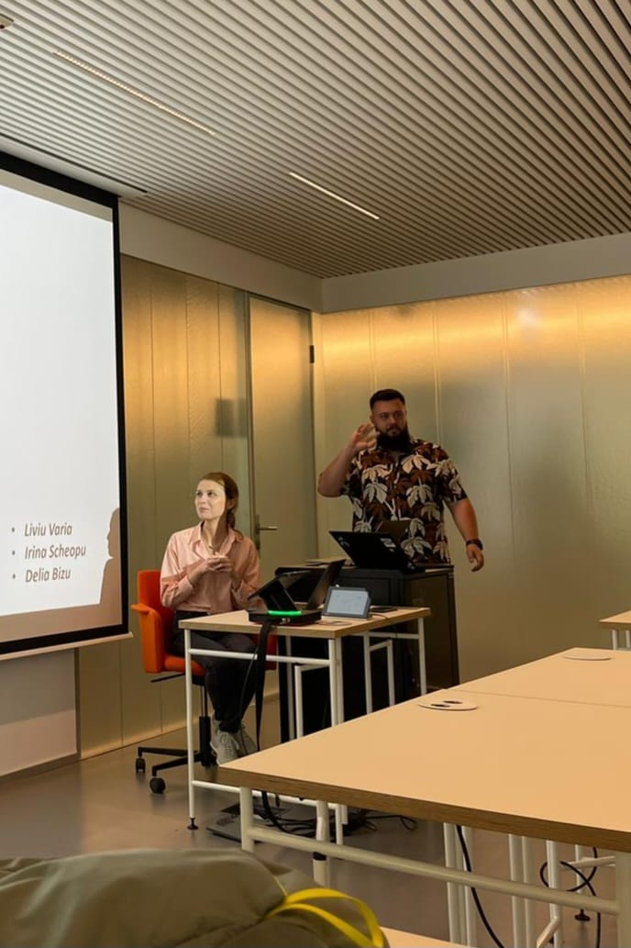
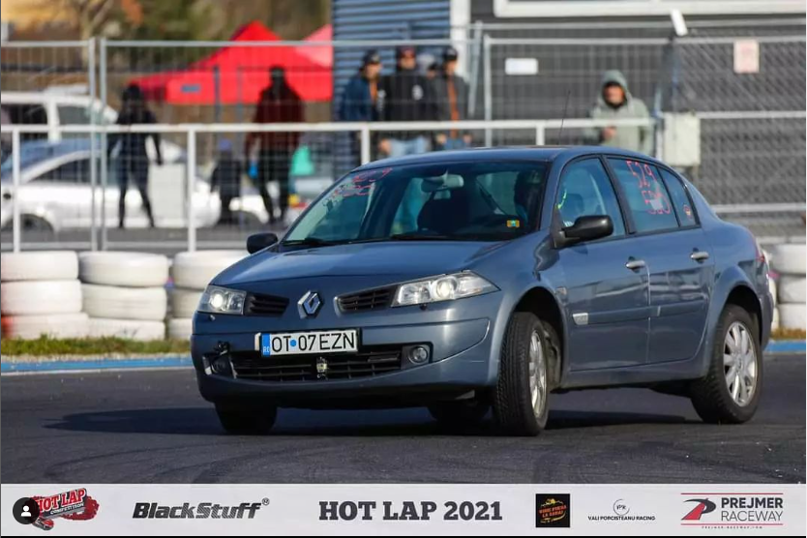
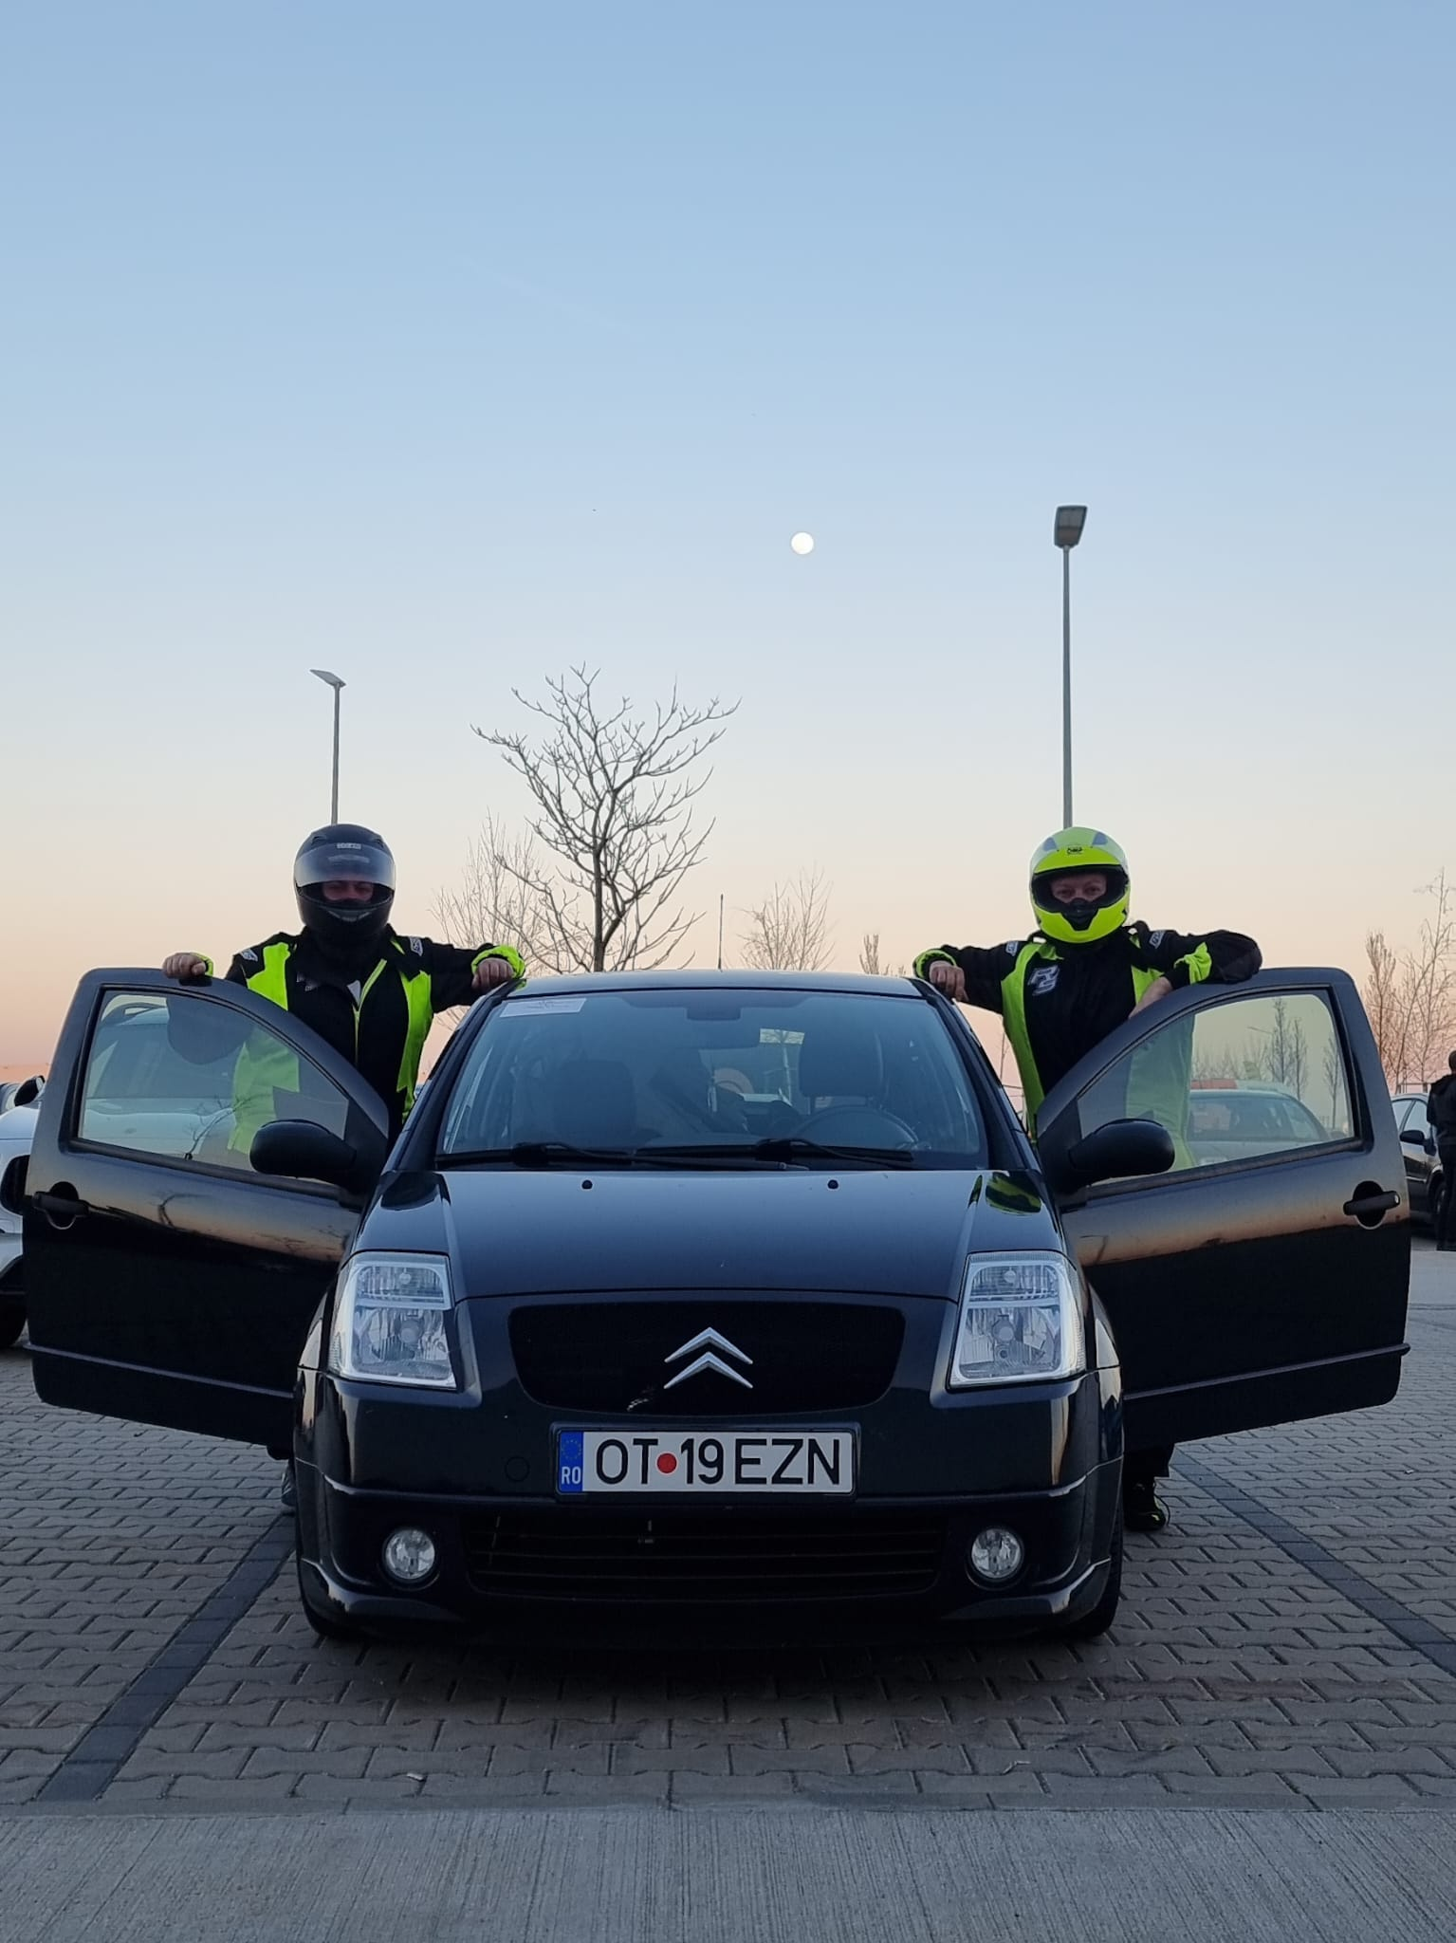
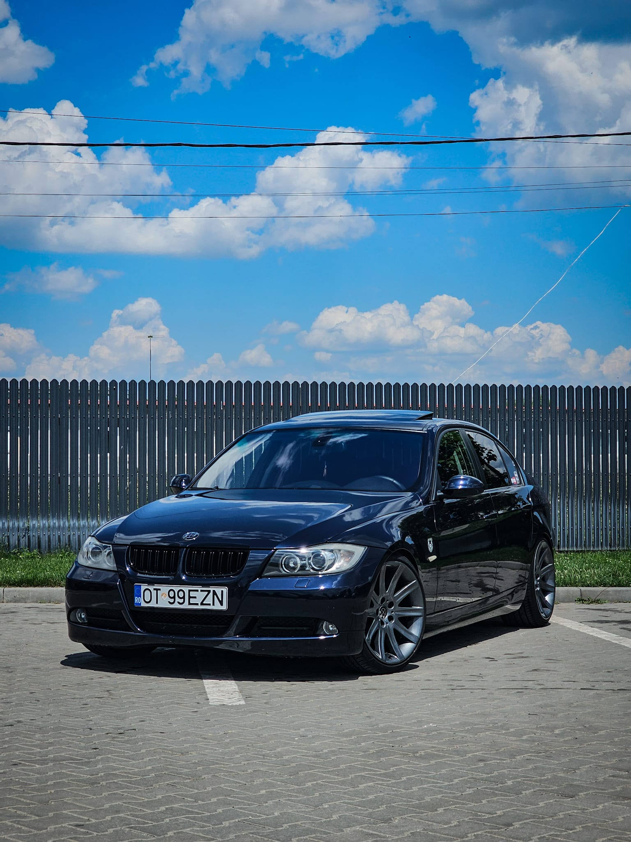
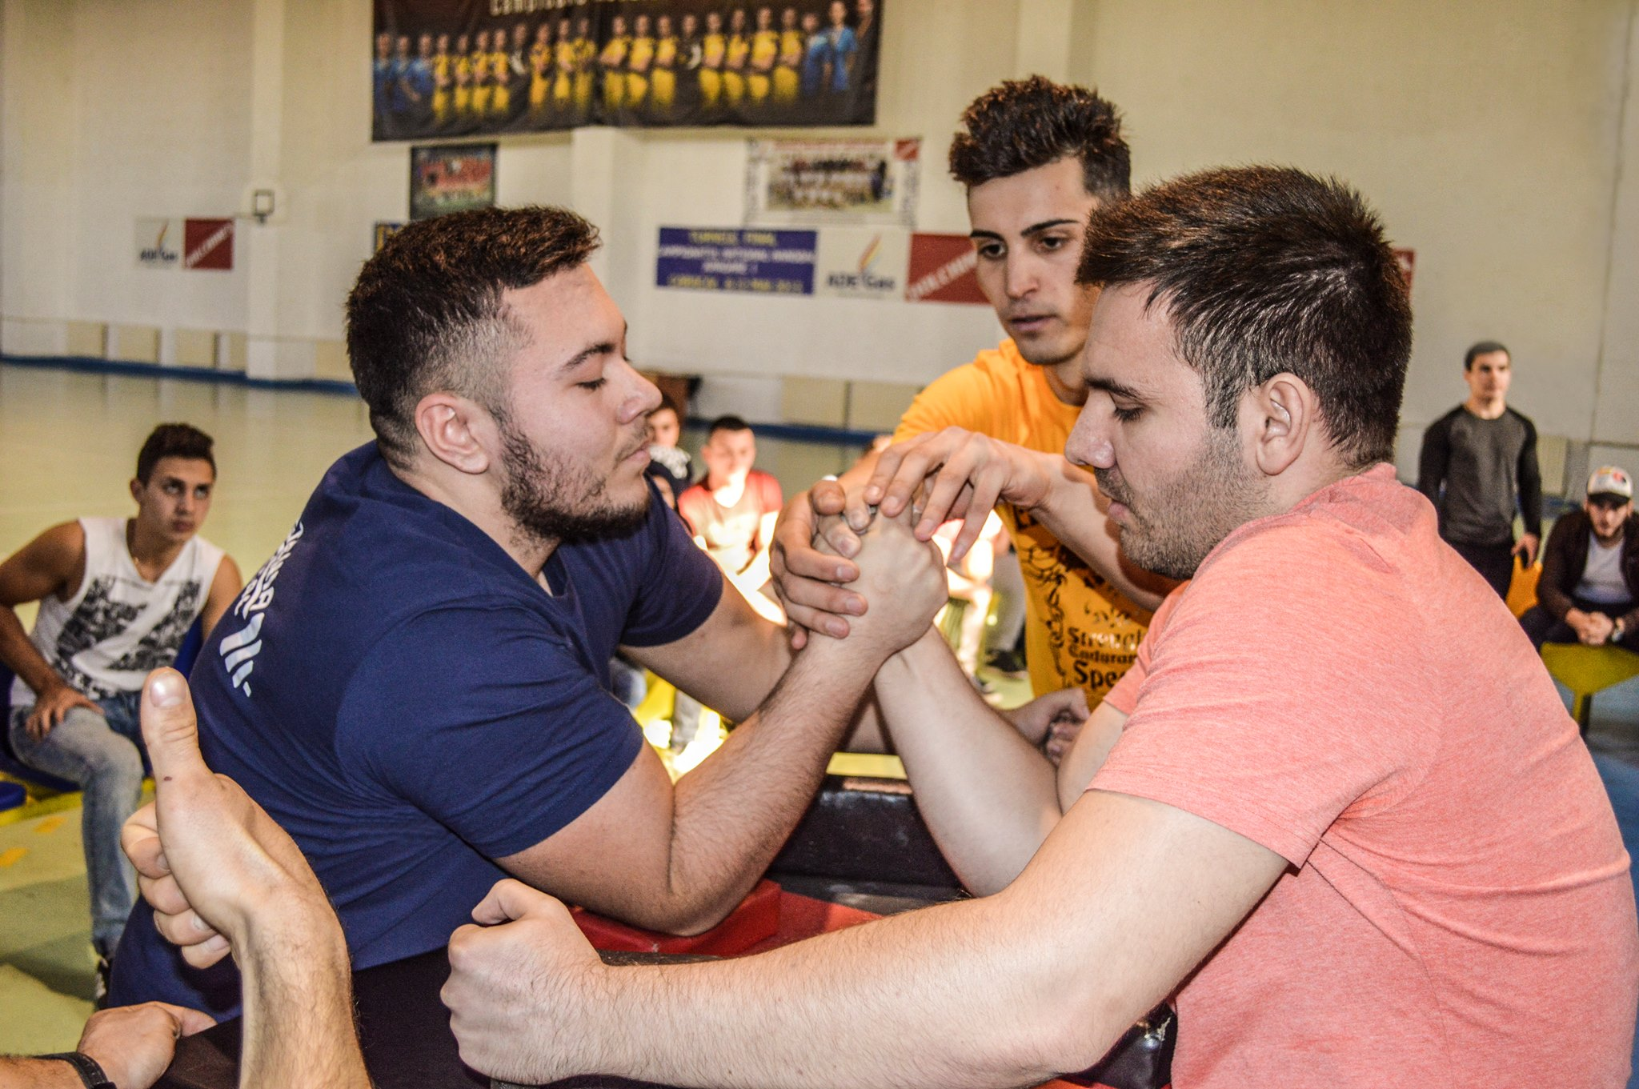
Liviu Varia

Slide 7
Who are you?
Hobbies, passions, interests

Slide 8
Welcome word
from ???? TODO

Slide 9
The program
14 lessons (theoretical and practical, some of them will have homeworks);
lesson 12 reserved for planning the final project;
lesson 14 reserved for presenting the final project;
almost each lesson has a different trainer;
time from lesson 12 will also be used for presenting vacancies suited for you from ING Hubs;
after the DevSchool is over, you will get the chance to apply to one of the presented vacancies and continue with the recruitment proccess;
all the needed materials for the lessons will be stored in GitHub;
either Andrada, Maria, Liviu or colleagues helping us will be present at any lesson if you have questions about the program;

Slide 10
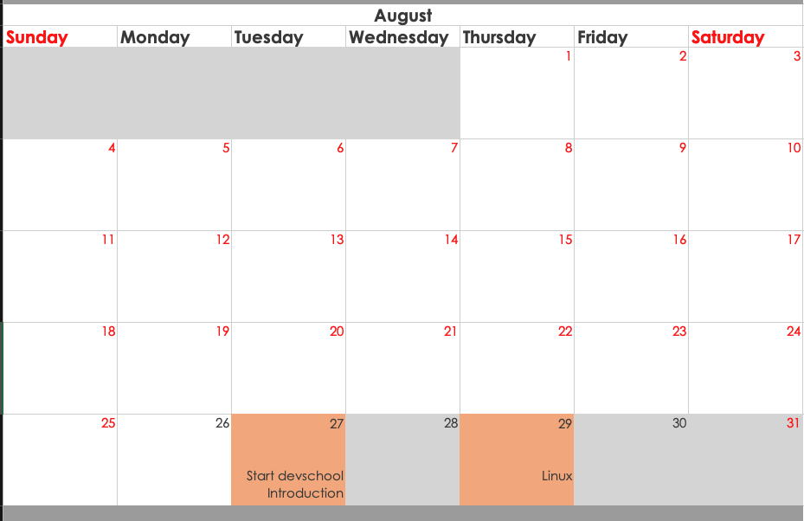
The calendar

Slide 11
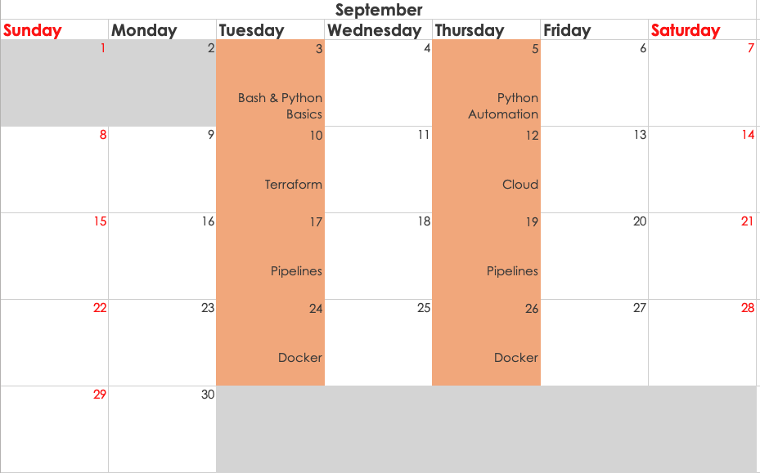
The calendar

Slide 12
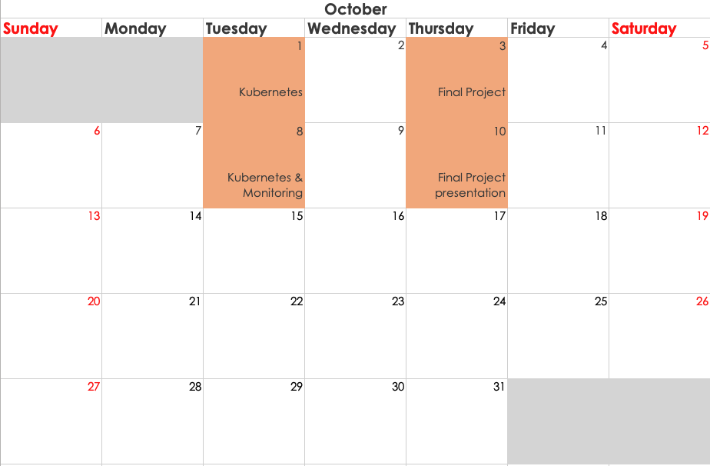
The calendar

Slide 13








Thank you!
ing.com
@ING_News
LinkedIn.com/company/ING
SlideShare.net/ING
Medium.com/ing-blog
ingwb.com
Facebook.com/ING
YouTube.com/ING
Flickr.com/INGGroup

